Slide 1
Second-Hand Car Trade Using Blockchain
By:
Arun Pradeep 195002014
Bhavna Magendiran 195002021
Guided by:
Dr. S. Mohanavalli

Slide 2
OUTLINE
Introduction
Problem statement
Challenges
Proposed model
  System flow diagram
  System architecture diagram
  Blockchain type
  Consensus algorithm
  Blockchain platform
Expected outcomes
Project timeline
Literature survey
Challenges faced
References

Slide 3
INTRODUCTION
Second hand car trade
Why?
  Primary motivation: Pre-owned car ownership cost is cheaper than new ones.
  Pandemic situation: People started preferring individual mobility.
  Trends in India: Growing middle class and young population, steady increase in disposable income.
Traditional method - Disadvantages
  Lack of trust
  Data asymmetry between buyer and seller
  Tedious paperwork
Notes:
A

Slide 4
INTRODUCTION
Blockchain
Distributed ledger
Decentralised database, data transparency and traceability
Consensus algorithm
Data integrity and reliability
Smart contracts
Automate business logic
Notes:
A

Slide 5
PROBLEM STATEMENT
To develop a used car transaction management system using blockchain to overcome lack of trust and data asymmetry prevailing in the traditional system.
Notes:
B

Slide 6
CHALLENGES
Lack of trust
  Data traceability - maintenance records, accidents history, insurance claims
Due to lack of enough information sellers are concerned about the fraudulent practices such as odometer fraud, which can result in unpredictable maintenance cost usually more than they should for the car.
Data asymmetry
  Single point of control / Centralised control
In any traditional used car market, a central authority has complete control over the data and can potentially exploit the single point of control of any centralised system, i.e., they can hide or change or forge the data. Since the seller often has more information about the car's history, condition, and potential issues than the buyer does, the buyers feel uncertain and hesitant about purchasing a used car because they feel the bargain is unfair without complete information.
Notes:
B

Slide 7
PROPOSED MODEL
System Flow Diagram
System Architecture Diagram
Blockchain Type
Blockchain Platform
Consensus Algorithm
Notes:
A

Slide 8
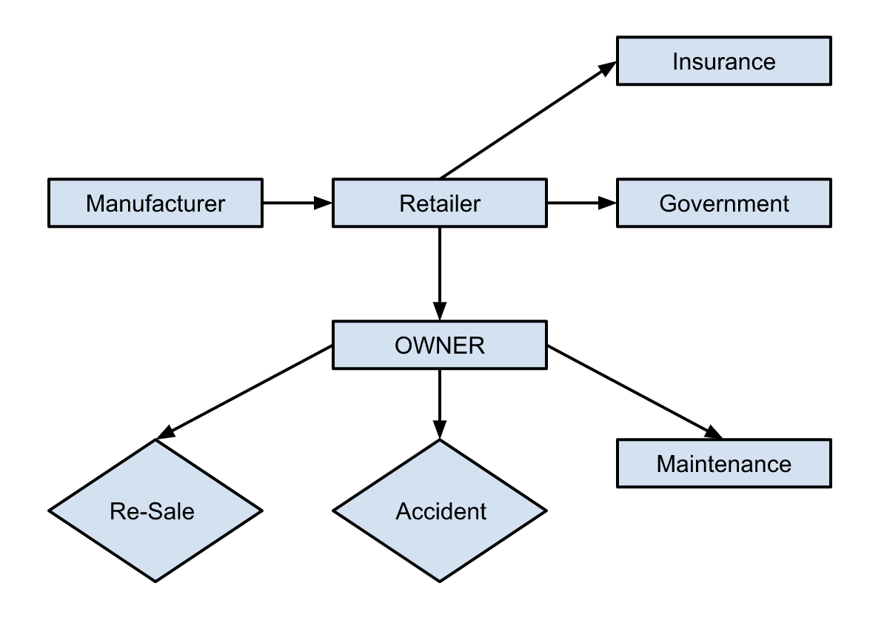
SYSTEM FLOW DIAGRAM
Notes:
A

Slide 9
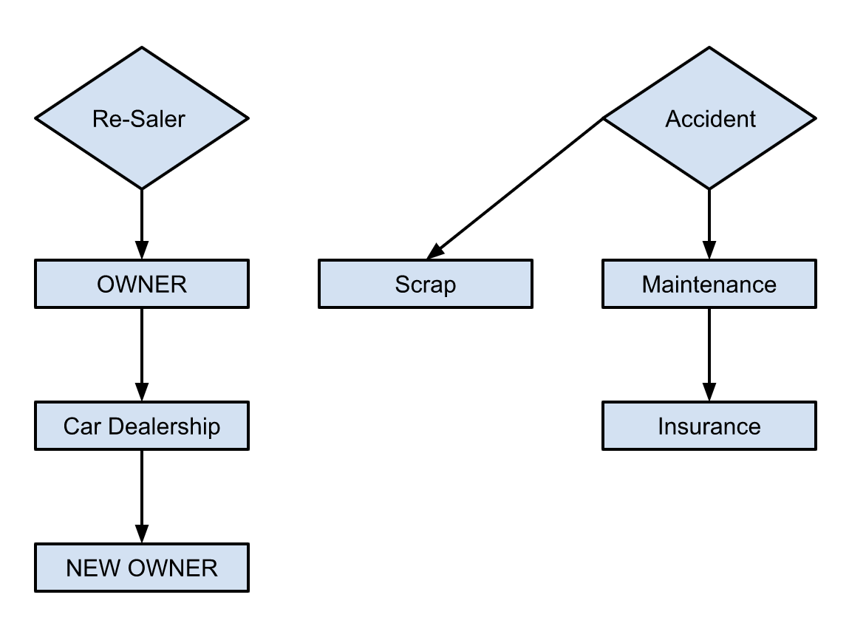
SYSTEM FLOW DIAGRAM

Slide 10
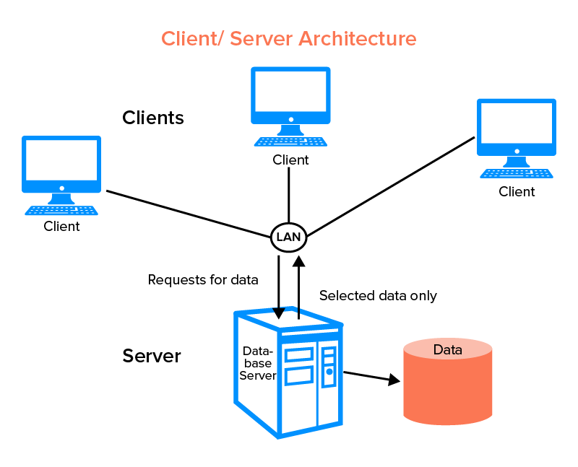
CLIENT SERVER ARCHITECTURE

Slide 11
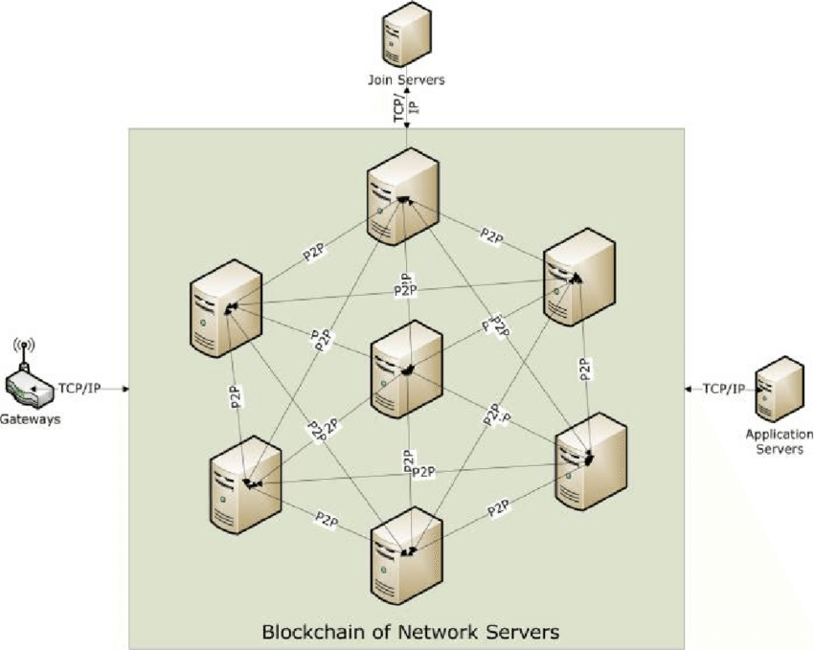
BLOCKCHAIN ARCHITECTURE

Slide 12
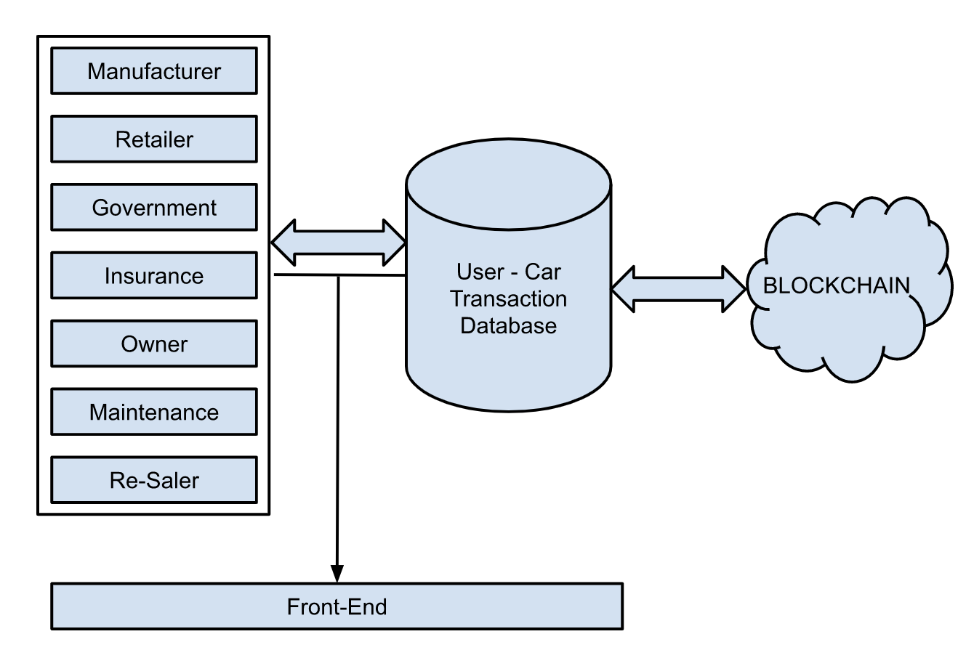
SYSTEM ARCHITECTURE DIAGRAM
Notes:
B

Slide 13
BLOCKCHAIN TYPE
BLOCKCHAIN | PUBLIC | PRIVATE | HYBRID
ADVANTAGE | Decentralization and transparency | Enhanced privacy and security | Flexibility and customization
DISADVANTAGE | Scalability and transaction costs | Centralization and trust | Complexity and maintenance
CHOSEN Blockchain type: HYBRID
Notes:
A
Public blockchain: Public blockchains, such as Bitcoin and Ethereum, are open to anyone who wants to participate. Anyone can download the software, create an address, and start making transactions. Public blockchains are decentralized and often use a proof-of-work (PoW) or proof-of-stake (PoS) consensus mechanism to validate transactions and secure the network.
Private blockchain: Private blockchains are typically used by businesses or organizations for internal purposes. They are not open to the public and access is restricted to a select group of participants. Private blockchains are usually run by a single entity and use a consensus mechanism that is different from that of public blockchains.
Hybrid blockchain: Hybrid blockchains combine elements of both public and private blockchains. They allow for some transactions to be public and transparent, while others are kept private and secure. Hybrid blockchains can be useful for industries that require both privacy and transparency, such as supply chain management or healthcare.

Slide 14
CONSENSUS ALGORITHM
Consensus Algorithm | ADVANTAGE | DISADVANTAGE
Proof of Work (PoW) | Well-established, secure, difficult for attackers to manipulate | Energy-intensive, large amount of computing power to solve cryptographic puzzles
Proof of Stake (PoS) | Energy-efficient, lower electricity consumption and a lower environmental impact | vulnerable to centralization, most stake in the network may have more influence over decision-making
Delegated Proof of Stake (DPoS) | more efficient and scalable, smaller group of network validators who are elected by stakeholders, faster transaction validation. | vulnerable to collusion or vote buying
Byzantine Fault Tolerance (BFT) | highly secure, designed to tolerate faults and malicious behavior, require high levels of reliability and fault tolerance. | less scalable, slower transaction times and higher network overhead.
Consensus algorithm CHOSEN: DPoS
Notes:
A 1st two
B 2nd two

Slide 15
BLOCKCHAIN PLATFORM
Blockchain Platform | ADVANTAGES | DISADVANTAGES
Ethereum | Smart contract functionality | Scalability issues
Bitcoin | Established network and security | Limited functionality
Hyperledger | Business-focused | Technical complexity
Cardano | Focus on sustainability | Limited adoption and network effects
Binance Smart Chain | Low transaction fees | Centralization concerns
Blockchain Platform CHOSEN: Hyperledger
Notes:
B

Slide 16
EXPECTED OUTCOMES
PHASE 1 | Planning Phase | Requirements of the project, identifying business problem
PHASE 2 | Design Phase | Blockchain architecture, other technical details
PHASE 3 | Development Phase | Proof of concept, development of application
PHASE 4 | Deployment Phase | Deployment of application in test environment, testing
PHASE 5 | Production Phase | Deploying application
Notes:
A

Slide 17
PROJECT TIMELINE
 | WEEK 1 | WEEK 2 | WEEK 3 | WEEK 4 | WEEK 5 | WEEK 6 | WEEK 7 | WEEK 8
Proof of concept | 26th Feb - 4th Mar
Develop |  | 5th Mar - 25th Mar
Integrate |  |  |  |  | 26th Mar - 1st Apr
Test |  |  |  |  |  |  | 2nd Apr - 8th Apr
Deploy |  |  |  |  |  |  |  | 9th Apr - 15th Apr
Notes:
B

Slide 18
LITERATURE SURVEY
TITLE | SUMMARY | INFERENCES | AUTHORS
Blockchain based Secure Privacy Preserving Vehicle Accident and Insurance Registration | Proposes a blockchain based framework for reducing the time required by the vehicle's owner to report an accident and file an insurance claim. It is a blockchain based solution for a vehicle insurance network built on hyperledger fabric network. | Hyperledger Fabric Platform is used along with DLT (Distributed Ledger Technology) and PKI (Public Key Infrastructure) Transactions involved: Insurance transaction method Accident transaction procedure Repair transaction procedure Advantages of this system: Reduced human errors, Increased public interest, Greater scalability, Improved reliability, increased resiliency, improved auditability, greater verifiability, information ownership, improved access to information, increased data quality, greater transparency, reduced operational costs, improved efficiency and speed | Yadav AS, Charles V, Pandey DK, Kushwaha DS 2023

Slide 19
LITERATURE SURVEY
TITLE | SUMMARY | INFERENCES | AUTHORS
Blockchain Adoption in the Vehicle Leasing Business to Increase the Transparency of Transactions | To build a blockchain architectural model (DSS - Design Support System) to increase transaction transparency in the car rental business. Here smart contracts are used by renters and automobile owners to conduct transactions with mutually agreed terms. Various subscription services are involved such as automobile insurance, parking rental, toll road payments, vehicle inspection can be automated with smart contracts, payments can be done with cryptocurrency, saving time and money. | ADVANTAGES: No third party is required No central authority Accessible to anyone No transaction cost No infrastructure fees | Djajasinga ND, Mutaufiq A, Hasan MR. 2022

Slide 20
LITERATURE SURVEY
TITLE | SUMMARY | INFERENCES | AUTHORS
A study for efficiency improvement of used car trading based on a public blockchain | Used car transaction management system used to solve the problem of asymmetry of information between the seller and the buyer and provides a reliable transaction environment through smart contracts based on the public blockchain Ethereum. | The system uses IPFS (InterPlanetary File System) to store data using the Mongo database based on the Node.js server and returns the hash function stored in the smart contract. The server uses Web3.JS to interact with the functions of the smart contract and Tx to invoke the smart contract. The blockchain transactions are then sent to the Ethereum blockchain via Geth. User and commands: Personal user - User used car listing, Vehicle information inquiry, Used car list inquiry, Contract writing, Contract lookup, Messenger Manufacturer, Insurance Company & Auto Body Shop - My vehicle status, Vehicle status update, Vehicle information inquiry | Seung Gyun Yoo, Byeongtae Ahn 2021

Slide 21
LITERATURE SURVEY
TITLE | SUMMARY | INFERENCES | AUTHORS
Blockchain-based vehicle condition Recording System for Second-Hand Vehicle Market | Proposes a use of blockchain architecture provided by Ethereum to record the information of vehicle condition.Here smart contracts are used to create decentralized applications which will be used to construct the vehicle condition recording system. | Smart contracts in Ethereum are written using solidity which is then compiled to Ethereum bytecode and run the code in EVM (Ethereum Virtual Machine). The system is built on Go Ethereum (private network), uses Clique PoA consensus algorithm and smart contracts are used for access control. Limitations of the system: Relies on an existing system and hence the overall performance is finally determined by it. | Jiang YT, Sun HM. A 2021

Slide 22
LITERATURE SURVEY
TITLE | SUMMARY | INFERENCES | AUTHORS
Second-Hand car Trading Framework based on Blockchain in Cloud Service Environment | To use blockchain technology as an auxiliary means to solve the long-standing problems in the used car market. The blockchain based transaction framework is built in the cloud service environment. | Second hand car trade problems: Selling cars as new ones Mileage fraud Tampering with VIN - Vehicle Identification Number Concealing accident vehicle Testing standards are not unified Appraisal standard nit unified Hard to fulfill service promise Consumers lack of professional identification ability Opaque circulation information Limitations: If a car manufacturer did not obey the law and forged documents in the very beginning in order to make profits. It cannot reach 100% accuracy for the mileage usage. Must improve the work efficiency between nodes and make sure the normal operation of the framework. | Yu Y, Yao C, Zhang Y, Jiang R. 2021

Slide 23
LITERATURE SURVEY
TITLE | SUMMARY | INFERENCES | AUTHORS
A Blockchain-Based System for Recording Vehicle Conditions for the Used Car Market | Proposes a blockchain-based system for recording the condition of second-hand vehicles in order to create a more transparent and trustworthy market for used vehicles, by providing an immutable record of the vehicle's condition that cannot be altered or deleted. | System users: Vehicle manufacturer, Maintenance plant, Government branch, Customer, Second-hand vehicle dealer, Authority node. System operations: Log-in process Operation of customer: authenticate to query vehicle information Operation of vehicle manufacturer: input the initial information of the vehicle and deploy the contract Operation of maintenance plant: record maintenance history and mileage of vehicles Operation of government branch: maintain ownership history System evaluation: Gas Limit and Transaction Throughput | You-Ting Jiang, Hung-Min Sun 2020

Slide 24
LITERATURE SURVEY
TITLE | SUMMARY | INFERENCES | AUTHORS
Towards Transparency and Trustworthy: a Used-Car Deposit Platform Based on Blockchain | A used car trading system based on Blockchain technology to provide a transparent and trustworthy trading channel for used car buyers and sellers, including used car platforms, banks, insurance companies and corresponding used car dealers. | System model is divided into six modules: the underlying service module, a consensus module, a data integration module, the token module, an estimation module, and a transaction module. System architecture is divided into three levels: Blockchain system, automatic valuation component, and the client. Technical route: Chaincode to operate ledger, Hyperledger fabric (consortium blockchain), optimized BFT consensus protocol and P2P communication protocol (consensus algorithm). | Jinyu Zhang, Honghui Zhao, Yumeng Yang, Jiaqi Yan 2019

Slide 25
CHALLENGES FACED
Small workshops which doesn’t have access to technology cannot update changes to the blockchain.
Data can be potentially manipulated in the manufacturing phase.
Notes:
B

Slide 26
REFERENCE
Yadav AS, Charles V, Pandey DK and Kushwaha DS (2023), Blockchain based Secure Privacy Preserving Vehicle Accident and Insurance Registration
Djajasinga ND, Mutaufiq A and Hasan MR (2022), Blockchain Adoption in the Vehicle Leasing Business to Increase the Transparency of Transactions
Seung Gyun Yoo and Byeongtae Ahn (2021), A study for efficiency improvement of used car trading based on a public blockchain
Jiang YT and Sun HM. A (2021), Blockchain-based vehicle condition Recording System for Second-Hand Vehicle Market
Yu Y, Yao C, Zhang Y and Jiang R (2021), Second-Hand car Trading Framework based on Blockchain in Cloud Service Environment
You-Ting Jiang and Hung-Min Sun (2020), A Blockchain-Based Vehicle Condition Recording System for Second-Hand Vehicle Market
Jinyu Zhang, Honghui Zhao, Yumeng Yang and Jiaqi Yan (2019), Towards Transparency and Trustworthy: a Used-Car Deposit Platform Based on Blockchain

Slide 27
THANK YOU

